Slide 1
Prema Court
A purpose-built residential service in the heart of the community for adults with severe and enduring mental health needs

Slide 2
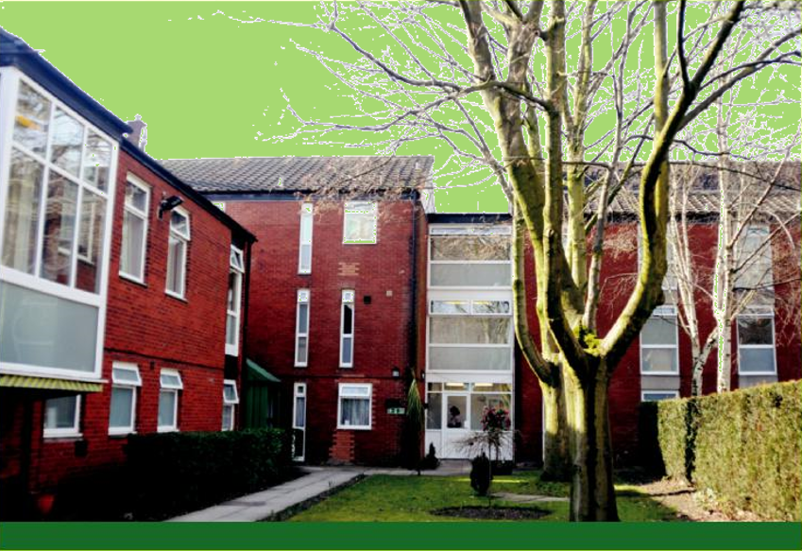
Based in the heart of Manchester, Prema Court specialises in caring for individuals requiring ongoing assistance with essential living skills who may be at significant risk of self-neglect or exploitation.
Prema Court
Prema Court is a residential service offering support and rehabilitation for adults experiencing a wide range of mental health issues. Centrally located in Old Trafford, Manchester, it is ideally situated to take advantage of excellent local facilities and transport links as well as all of the attractions of a major city.
Deepdene Care, an established national mental healthcare provider, has operated Prema Court since their acquisition in 2008. With services operating throughout the UK, the group has developed strong and stable compliance, governance and central support frameworks which Prema Court benefits from.
Prema Court is a specialist service offering solutions for adults with a history of behaviours which often result in placement difficulties. Residents at Prema Court often exhibit complex mental health needs including severe and enduring mental illnesses, challenging behaviour, and drug or alcohol dependency. We are well equipped to accommodate those who exhibit behaviours such as self-harm, and individuals with a forensic history, or dual diagnosis.
Individual care
A purpose-built service meeting the needs of up to 44 residents Prema Court is spread over three floors and two buildings, Clifton House and Brook House, offering spacious accommodation and facilities including individual lounges, residents ‘s kitchens, communal dining and recreational areas. Residents at Prema Court are supported by a skilled leadership team, care staff and ancillary team who provide 24-hour support in daily life as well as activities.
Prema Court provides a particularly high level of support to its residents, who are encouraged to focus on their recovery through the provision of individually tailored care plans that are outcome based. These address the practical, social and psychological needs of each person, enabling them to live as independently as possible.
Residents are encouraged to focus on their recovery by working with us to develop individualised pathways of care that encourage positive risk taking and focus on individuals’ strengths and aspirations, enabling them to take an active part in their care and rehabilitation program.
Positive outcomes
Our residents are individuals in their own right with their own specific and often complex needs, and personalisation is a key element of our service. Our goal is to offer the range of support needed to enable the individual to work towards achieving the most positive outcome for them, whether a return to independent living and employment, or to a supported environment where they can access all the services the community has to offer.

Slide 3
What we offer: We offer people over the age of 18 years old a chance to live in a community and take control of their lives through intensive support from our well-trained team. Residents are integral in their own recovery in which we support them in medication therapy if required, meaningful daily skills development and community integration. By providing a range of enjoyable activities individually and in groups within the home and the community, this helps to promote independence and purpose. The progress is measured through health and social care outcomes, which matter most to residents, carers and regulatory bodies. For our Residents: An opportunity to live in a homely environment and develop independence. Staff team who can understand your difficulties, work with you and incorporate your views and wishes when making decisions about you. To support you to achieve independence through education, vocational training and voluntary work experience placements. The opportunity to take part in resident meetings and internal surveys so your views can be heard and listened to. Sign posting to advocacy services that will support you to represent your views if required. A range of professionals who can provide information and support you to manage your mental health problems and difficulties.
For Families: A staff team who you can trust and have regular contact with. A consistent group of professionals who are with you throughout the journey of your family member. Involvement in your family member’s care and all views to be taken on board. Support to maintain and improve the relationship with your family member. To support you to understand your family member’s difficulties and any treatment that they are receiving. Confidence that the staff looking after your family member are well trained Family/carers are made to feel welcome when visiting the home. Feedback questionnaires/surveys are made readily available to obtain views from family members. For Commissioners: Bespoke package of care to meet the individuals’ complex mental health and social care needs Consistency of care through in house mental health team. Experience and expertise of the mental health team ensuring reduction in hospital admissions. Recovery and Quality assurance through outcomes. 24 hours home management on call to provide crisis management. Staff competent and trained in their roles

Slide 4
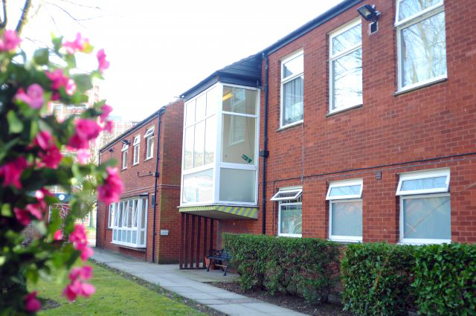
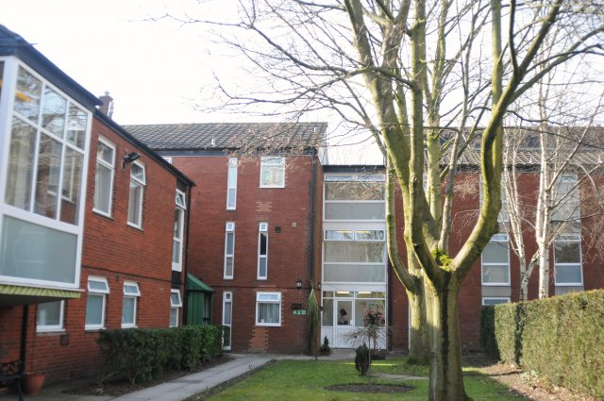
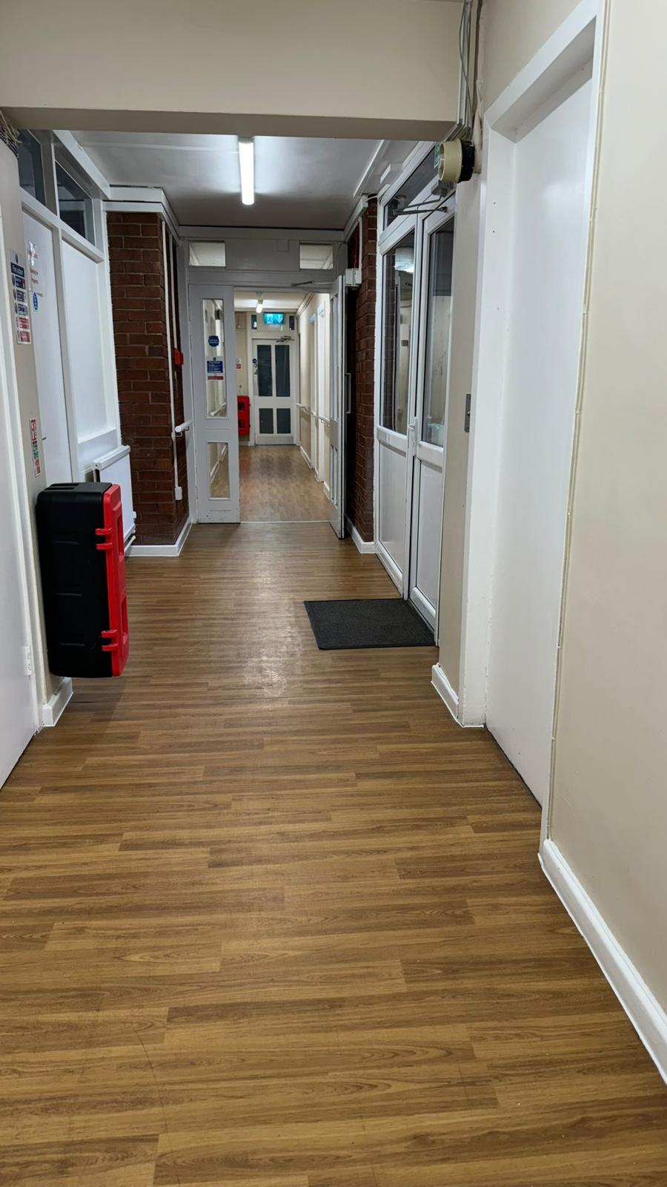
Creating a relaxing and homely environment for residents at Prema Court
Visit us at
www.deepdenecare.com

Slide 5
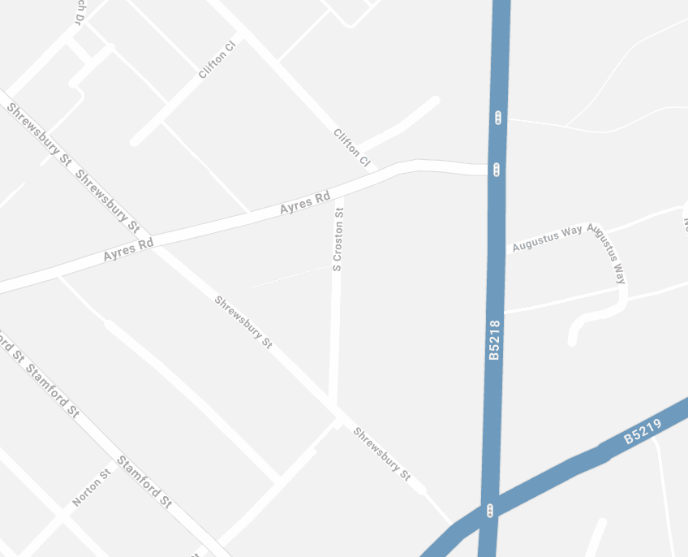
Referrals
At Deepdene Care we welcome referrals from all areas of mental health care and are committed to making this process as unobtrusive and stress free as possible.
The referral process is reactive and easy to use, with a direct line to our dedicated referral team.
Following a referral a senior member of our multi-disciplinary team will arrange to carry out a full assessment within 24 hours at a time and venue that best suits the individual’s need.
After this assessment our multi-disciplinary team will review the case, and if suitable, a placement offer and full breakdown of costs will be sent to the referring agency within seven working days.
Once the placement is agreed we will work closely with the individual and their care team to ensure a smooth and successful transition.
If you would like to arrange an informal visit, please contact us on our referral line:
0800 313 4774
www.deepdenecare.com
Prema Court
Clifton Close
Ayres Road
Manchester
M16 7NX
t: 0161 226 7698
e: referrals@deepdenecare.com
Deepdene Care: 2 The Courtyard, 707 Warwick Road, Solihull, West Midlands, B91 3DA t: 0121 387 2130 e: info@deepdenecare.com
How to find Prema Court:
Road:
Prema Court is easily accessible by road, and is just
five minutes from junction 3 of the M56, via A5103
Princess Parkway. Parking is available.
Public transport:
Bus routes 15 and 85 stop just outside Prema Court
Piccadilly Train Station is 20 minutes away.
Prema Court is a 15 minute taxi-ride from
Manchester Airport.

Slide 6
Prema Court’s Referral Criteria
ACCEPT | DO NOT ACCEPT
Residents with severe and enduring mental illnesses e.g. personality disorder, schizophrenia, bipolar etc. who currently need ongoing extensive support Dual diagnosis | Individuals with no mental health needs
Past offending behaviour Drug and alcohol misuse with a mental health diagnosis. Challenging behaviour Self-harm
Must be engaged with the mental health care team.
Adults: age range 18 + | Severe mobility issues. We have limited ground floor rooms. We cannot cater for residents with severe physical health issues e.g. severe, mobility issues, requiring intense personal care etc - we focus on mental health support and recovery
Male and female residents
Serious arson or sexual offences to be considered on a case by case bases
Residents on CTO / DOLS and other orders/restrictions | Children 0-17 years
Requiring ONLY prompts or limited personal care e.g. changing pads/clothes/bedding for incontinent residents.
Individuals requiring ongoing assistance with essential living skills that may be at significant risk of self-neglect or exploitation.
Deepdene Care: 2 The Courtyard, 707 Warwick Road, Solihull, West Midlands, B91 3DA t: 0121 387 2130 e: info@deepdenecare.com

Slide 7
Our other Care Homes’ Referral Criteria
Deepdene Court- West Sussex, BN17 5HS | Deepdene House- London, SW16 2EA | Norton Street- Manchester, M16 7GQ
Residents with severe and enduring mental illnesses e.g. personality disorder, schizophrenia, bipolar etc who currently need ongoing extensive support Dual diagnosis | Residents with severe and enduring mental illnesses e.g. personality disorder, schizophrenia, bipolar etc Dual diagnosis | Stable mental health/substance misuse. We are a step-down facility from residential setting, so a level of independence is required for all residents. Due to service provided over several independent houses a constant staff monitoring is not available
Past offending behaviour Drug and alcohol misuse with a mental health diagnosis. Challenging behaviour Self-harm | Past offending behaviour Drug and alcohol misuse Challenging behaviour Mild learning disability Early dementia care Self-harm | Residents with severe and enduring mental illnesses e.g. personality disorder, schizophrenia, bipolar, dual diagnosis Past offending behaviour Drug and alcohol misuse (under control) Self-harm (under control) Challenging behaviour (under control)
Must be engaged with the mental health care team. | Must be engaged with the mental health care team | Must be engaged with mental health care team.
Adults: age range 18 + | Adults: age range 18 + | Adults - age range 18 +
Male and female residents | Male and female residents | Male and female residents
Serious arson or sexual offences to be considered on a case by case bases | Serious arson or sexual offences to be considered on a case by case bases | Serious arson or sexual offences to be considered on a case by case bases
Residents on CTO / DOLS and other orders/restrictions | Residents on CTO / DOLS and other orders/restrictions | No CTO/DoLS restrictions
Requiring ONLY prompts or limited personal care e.g. changing pads/clothes/bedding for incontinent residents. | Requiring ONLY prompts or limited personal care e.g. changing pads/clothes/bedding for incontinent residents. | Requiring ONLY prompts or limited personal care e.g. changing pads / clothes / bedding for incontinent residents.
Individuals requiring ongoing assistance with essential living skills who may be at significant risk of self-neglect or exploitation. | Individuals requiring ongoing assistance with essential living skills who may be at significant risk of self-neglect or exploitation. | Individuals requiring ongoing assistance with essential living skills who may be at significant risk of self-neglect or exploitation.
Deepdene Care: 2 The Courtyard, 707 Warwick Road, Solihull, West Midlands, B91 3DA t: 0121 387 2130 e: info@deepdenecare.com

